Slide 1

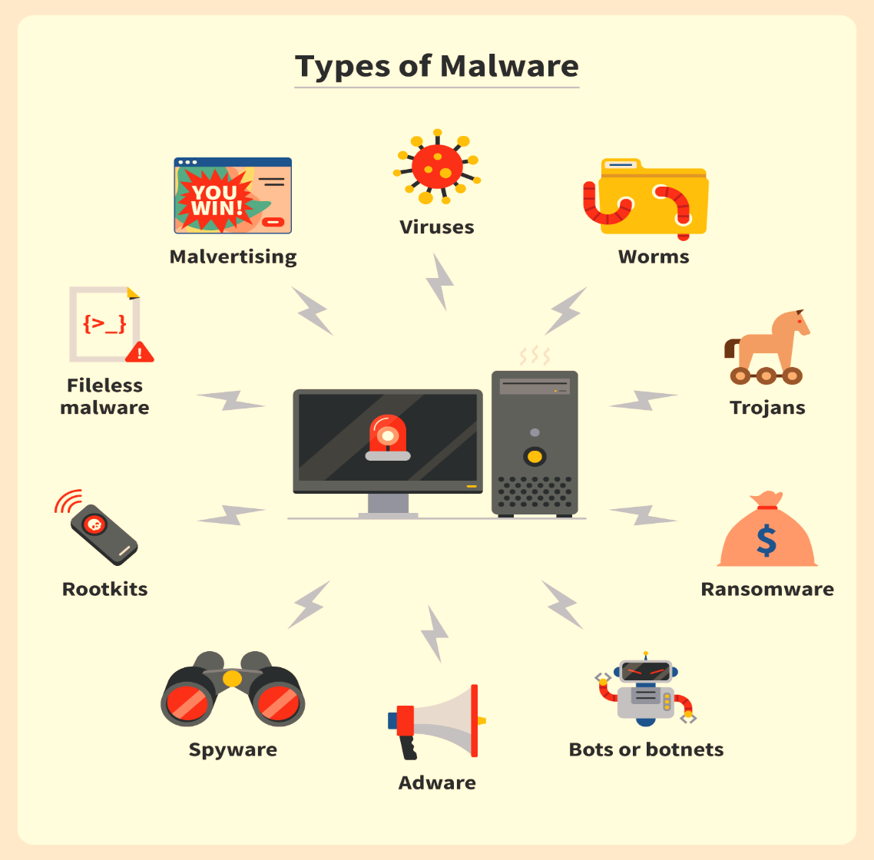





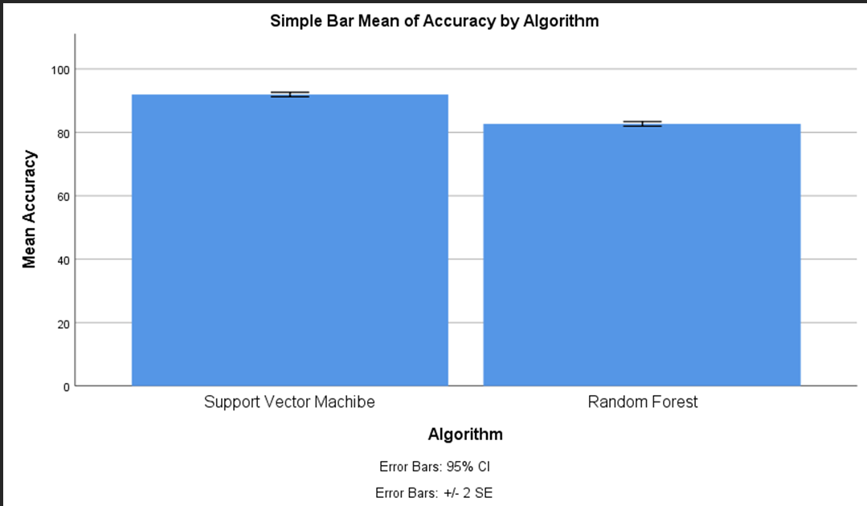
Name: Varun Kumar
Register Number: 192110128
Guided by: Dr. J.Joslin Jeya Sheela
Ms. Poorani.S
Guided by Dr. Mary Valantina. G
A Meta Classifier Model for Dispatch Spyware Discernment Using Support Vector Machines (SVM) Compared With Random Forest Algorithm
INTRODUCTION
The aim of the proposed model is to develop a meta classifier system capable of effectively discerning and identifying dispatch spyware.
Dispatch spyware refers to malicious software designed to secretly intercept and forward communications or data from a compromised device to a third party without the user's consent.
Spyware poses significant threats to privacy and security in modern computing environments. Detecting and preventing spyware infiltration is crucial for safeguarding sensitive information and maintaining system integrity.
The developed meta-classifier model can be applied in various real-world scenarios where spyware detection is necessary, such as Enterprise Security Systems, E-Cloud Security Solutions, Government and Défense Applications.
SVM can effectively classify data points into different categories; Random Forest is an ensemble learning method that combines multiple decision trees to improve classification accuracy and robustness.
The data set contains the Labelling , Data Processing , Serves as the primary dataset for testing and training.
Malware attack to Computers
MATERIALS AND METHODS
Pre-processing
Input data
Evaluation and Metrics
Output
Model Validation
Data Analysis and Training
Statistical Analysis values of Mean accuracy (91.93), Standard Deviation(1.335), and Standard error deviation. The Support Vector Machine Algorithm and the Random Forest algorithm have the values of the Mean accuracy, Standard Deviation, and Standard Error.
Comparison of Significance Level with value p<0.05. Both Support Vector Machine Algorithm and the Random Forest Algorithm have a confidence interval of 95% with the significance value 0.000( p<0.05).
RESULTS
Group Statistics
Independent Samples Test
 | Algorithm | N | Mean | Std. Deviation | Std. Error Mean
Accuracy | SVM | 15 | 91.93 | 1.335 | .345
 | RF | 15 | 82.67 | 1.397 | .361
 | Levene's Test |  | T-Test For Equality Of Means
 | F | Sig | t | df | Sig(2-tailed) | Mean difference | Std.Error difference | 95% Confidence
 |  |  |  |  |  |  |  | lower | upper
Equal Variance | .252 | .619 | 18.575 | 28 | .000 | 9.267 | .499 | 8.245 | 10.289
No Equal Variance |  |  | 18.575 | 27.941 | .000 | 9.267 | .499 | 8.245 | 10.289
DISCUSSION AND CONCLUSION
Support Vector Machine Algorithm accuracy of (91.92%) and it has the mean accuracy of the Random Forest algorithm (82.67%) . The mean accuracy of the Support Vector Machine Algorithm has no significant difference with the Random Forest algorithm with the significance value is 0.000 (p<0.05) .
The future impact of a meta-classifier model for dispatch spyware discernment using SVM compared with Random Forest will depend on advancements in machine learning techniques, data availability and quality, computational power, feature engineering and selection, and robustness against adversarial attacks.
SVMs tend to produce complex decision boundaries, Random Forests provide feature importance measures that can offer insights into the significance of different features in the classification process.
The proposed framework for spyware detection analysis has the accuracy of 91.93% for Support Vector Machine Algorithm compared with the Random Forest Algorithm having the accuracy 82.67%.
The proposed framework proves that the Support Vector Machine has better significant accuracy than the Random Forest Algorithm.
BIBLIOGRAPHY
J Sahs, L Khan - 2012 European intelligence and security ,A machine learning approach to android malware detection.
Roopak Surendran, Md. Meraj Uddin, "On Impact of Semantically Similar Apps in Android Malware Datasets", 2023 IEEE International Conference on Recent Advances in Systems Science and Engineering (RASSE), pp.1-6, 2023.
K. Jasmine, R. Sivaranjani, J. Jebastine, K. Murugan, "Malware Detection and Classification with Machine learning Models", 2023 International Conference on Applied Intelligence and Sustainable Computing (ICAISC), pp.1-8, 2023.
Pallavi V. Baviskar, Guddi Singh, Vijay Narendranath Patil, "Design of Machine Learning-Based Malware Detection Techniques in Smartphone Environment", 2023 International Conference for Advancement in Technology (ICONAT), pp.1-5, 2023.
Sándor, József, Roland Nagy, and Levente Buttyán. 2024. “PATRIoTA: A Similarity-Based IoT Malware Detection Method Robust Against Adversarial Samples.”

